Slide 1

Forecasting using data
Thank you to the attendees, sponsors and organizers.
#ACECONF
ACE! 2018
Troy Magennis
@t_magennis | troy.magennis@focusedobjective.com
All slides and spreadsheets: Bit.ly/SimResources
Notes:
Welcome the Forecasting using Data session.
I’m Troy Magennis, and I’ve got 40 minutes to convince you that Forecasting is both
easier than you think,
and likely to outperform your intuition.

Slide 2

Notes:
Forecasting is about setting better expectations about what reality will eventually unfold.
Expectations are subject to all manner of biases, wishful thinking and incomplete logic. Out job in forecasting is to narrow that gap, better align forecast to reality.
Its about demonstrating we understand the wholistic delivery system well enough that we can make better, more informed decisions earlier.

Slide 3
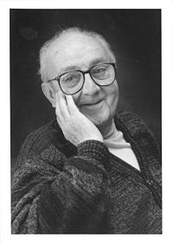
“Remember that all models are wrong; the practical question is how wrong do they have to be to not be useful.”
Statistician, George Box

Slide 4
Better than intuition or whatever you do now.
Not perfect. Not exact. Not always right.

Slide 5
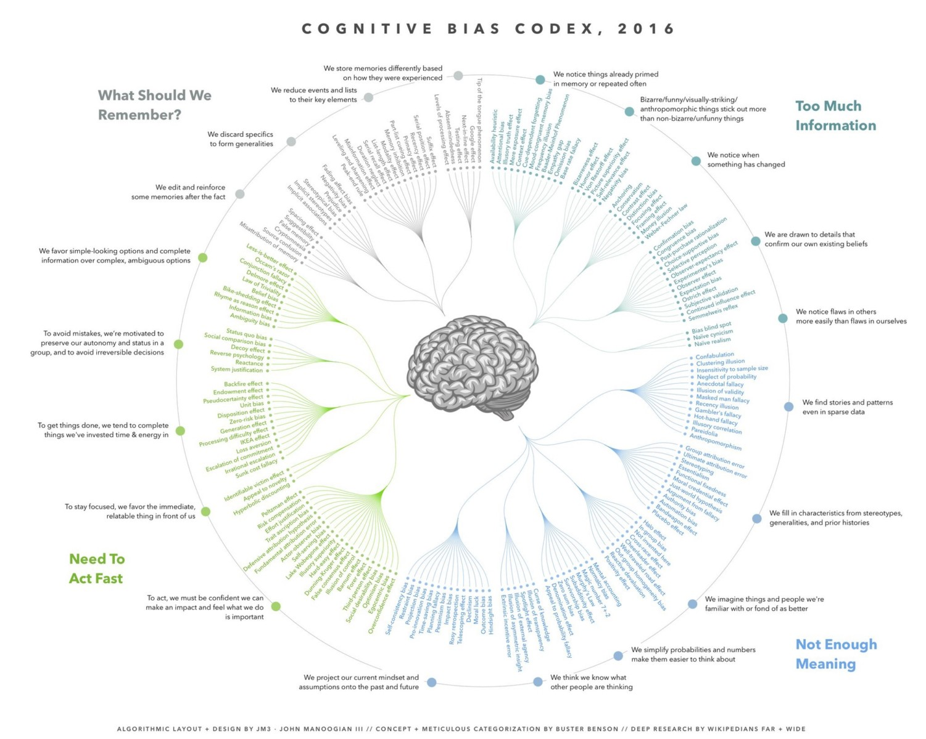
http://ritholtz.com/2016/09/cognitive-bias-codex/

Slide 6
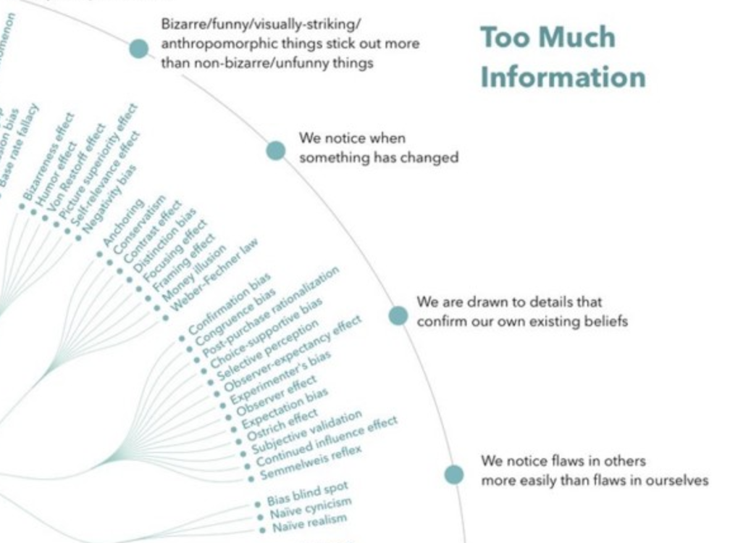
http://ritholtz.com/2016/09/cognitive-bias-codex/

Slide 7
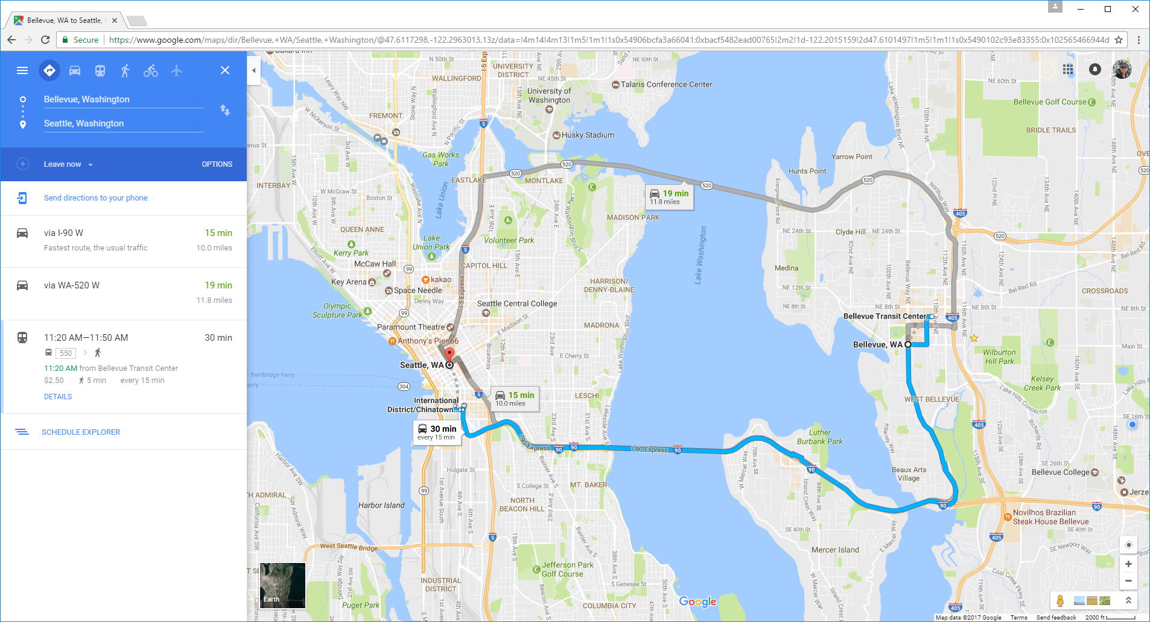
Forecasting
How Big
How Long
How Much
Fails
Q and A
Multiple Options – NOT one…
Duration not ETA until commitment…
Continuously updated once started…
Notes:
Google Maps emerged about 10 years ago. It’s now pretty ubiquitous when we want to travel in unfamiliar areas that we se our phones to navigate. It has save my and many other marriages I suspect.
Being around for 10 years means its undergone a lot of refinement, and is a pretty good reference to learn how to present forecass.
There is some subtleties that we can easily use in forecasting software and IT projects.
First off, it doesn’t show just one option, it shown many. Here, two driving alternatives and a public transport alternative. It keeps the human in the decision loop. It presents options, even highlighting the fastest one, but it clearly shows the others in case there is some compelling reason they are useful.
Second, it doesn’t give an arrival time yet. It gives duration. Obviously, it doesn’t yet know when we are leaving home.
Thirdly, once we do commit to one of the options, it gives us continuously updated arrival time information. It incorporates the latest traffic issues based on traffic flow ahead of us and even suggests alternative routes if its original turns out to be less ideal.

Slide 8

Contrast Google Maps to Software Estimates
Forecasting
How Big
How Long
How Much
Fails
Q and A
If you currently…
Consider doing…
Give one forecast even though multiple approaches considered
Give a calendar date for undefined “complete” & “start”
If the original date is in doubt we find out near the end
Appear on-time until we are not. Measure progress from start.
Give multiple options of investment and implementation
Give a duration and define what started & complete means
If the original date is in doubt, know earlier and react faster
Report remaining time to deliver not time since started
Notes:
So, lets incorporate that into our world.
Lets NOT give a single answer, lets show the options we have considered in case they offer some advantage we haven’t considered.
Lets NOT give a calendar delivery date until the project has started, lets make decisions using duration in weeks or sprints as a way to decide what option to pick.
Lets NOT perform heroics at the very end of a project, lets continuously track our progress against the forecast and adapt and react quickly, earlier.
I’m going to show you how I incorporate these aspects into my forecasting engagements.

Slide 9
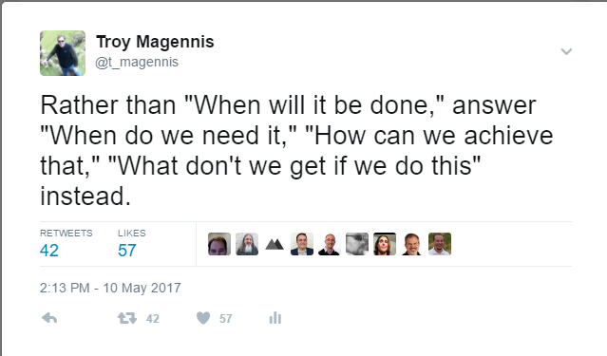
Top Three Forecasting Questions….
Forecasting
How Big
How Long
How Much
Fails
Q and A
How Big
Understanding the size of a feature or project with less effort
How Long
Understanding when a feature or project might be done
Tracking progress
How Much
OK, its too big, “what can I get by when…”
Seeing options
Making trade-off decisions earlier
Notes:
In our world of likely questions, I find three are the root elements that get assembled in different ways.
How Big, How Long, How Much.
When you are given a question to answer, think about how these questions will help you get to an answer. Even our ubiquitous “When” question is a How Big combined with a How Long answer.

Slide 10
Q1: How Big?
Forecasting
How Big
How Long
How Much
Fails
Q and A
Understanding the size of a feature or project with less effort
Notes:
Lets start at looking at how to answer the first, How Big.

Slide 11
Forecasting
How Big
How Long
How Much
Fails
Q and A
Known as Reference Class Forecasting
Notes:
Keeping a history of features and how many stories or story points it took to deliver those features is an excellent way to maintain knowledge and lessons over time.
Here is a quick and practical way. Whenever you deliver a feature, tally up the story count and a short description and place them on a wall somewhere sorted from lowest to highest.
When you are asked how big Feature 4 might be, walk over to the wall with the stakeholder and a few team members and pick where it fits. Done.
Teams doing this well can estimate size of 30 features an hour. Better still, the stakeholder start to get the feel of relative feature size quickly and only ask the team on rare occasions.
It has another benefit. It avoids all manner of cognitive biases and wishful thinking. It also captures that some even simple sounding work turned out hard by recording the eventual story count. This is an easy win for any organization.

Slide 12
Forecasting Total Story Count
Forecasting
How Big
How Long
How Much
Fails
Q and A
Question: How an I estimate the size of a feature or project without analyzing every piece of work?
Theory: The “size” patterns of randomly sample epics, will persist through all other epics. Analyze a few and compute for the many…
Notes:
As fast as reference count forecasting is, sometimes you don’t have relevant historical data and you want to dive a little deeper with the team on size and complexity. My call to action here is to take a sampling approach and to

Slide 13
Forecasting
How Big
How Long
How Much
Fails
Q and A
http://bit.ly/StoryCountForecaster
Sampling based Monte Carlo story count forecasting Excel spreadsheet

Slide 14
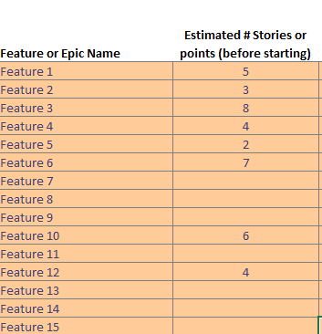
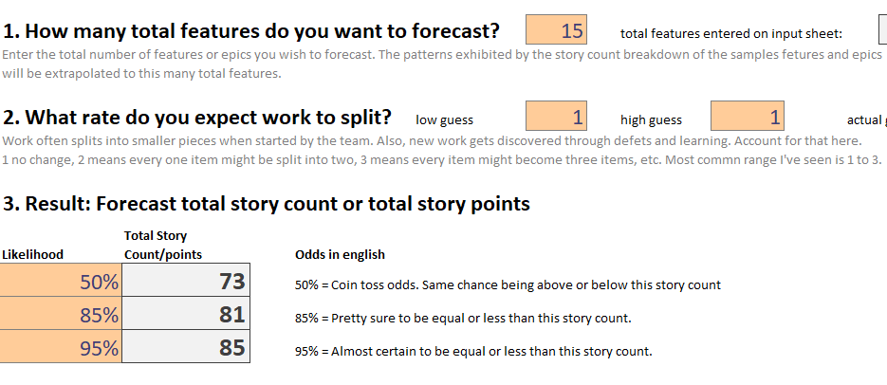
Forecasting
How Big
How Long
How Much
Fails
Q and A
Process to estimate total size –
Pick a 5-10 features at random
Build sets of 15 re-samples (say 1000 times)
The number of sets that reach certain story count levels give probability

Slide 15
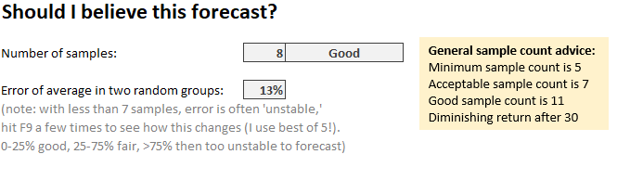
Why should I believe this forecast anyway?
Forecasting
How Big
How Long
How Much
Fails
Q and A
Sample Count: Keep cutting data and compare the result
Random groups: Split data into random groups and compare
Total for 100 Features using | Total Count 85% Likelihood
36 samples | 506
10 samples | 494
3 samples | 504
Average Error calculation –
Split the samples into 2 groups
Calculate the average of both groups
Compare the difference as a % of range error % = error of avg / (max-min)

Slide 16
Q2: How Long?
Forecasting
How Big
How Long
How Much
Fails
Q and A
Forecasting duration if nothing else was done…

Slide 17
Forecasting Duration (and delivery date)
Forecasting
How Big
How Long
How Much
Fails
Q and A
Question: How can I estimate the amount of time it will take to deliver a feature or project?
Theory: Using a range estimate or actual team delivery rate data, calculate how many of those periods of time to complete delivery

Slide 18
Forecasting
How Big
How Long
How Much
Fails
Q and A
http://bit.ly/ThroughputForecast
Estimate or Sampling based Monte Carlo duration and date forecasting Excel spreadsheet

Slide 19
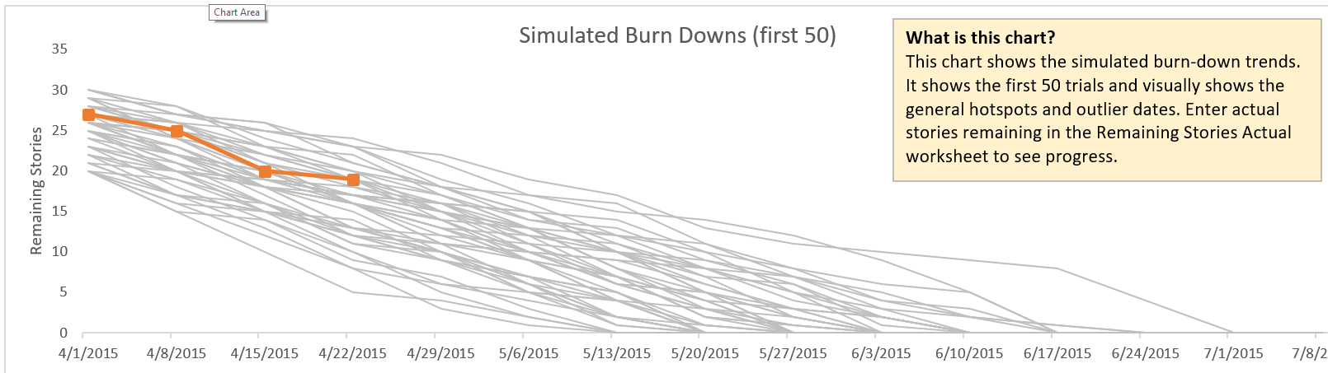
Forecasting
How Big
How Long
How Much
Fails
Q and A
More
Luck
Less Luck
Less
Likely
More Likely
85%

Slide 20
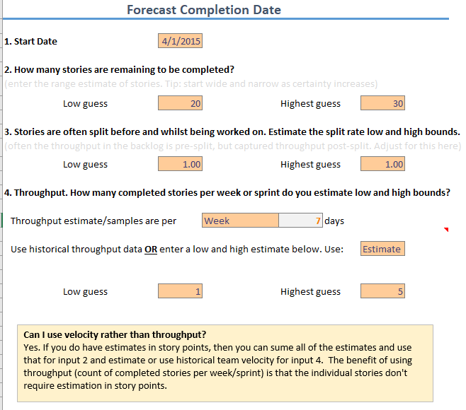
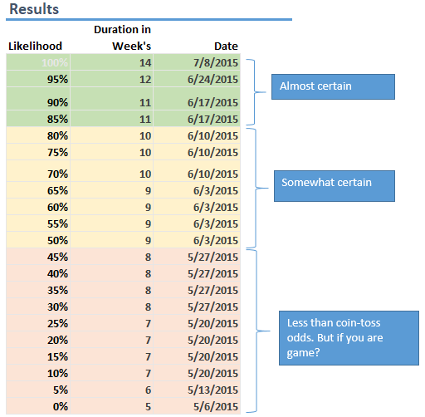
Forecasting
How Big
How Long
How Much
Fails
Q and A

Slide 21
Q3: How Much?
Forecasting
How Big
How Long
How Much
Fails
Q and A
OK, what can we get?

Slide 22
Forecasting How Much (OK, what can I get?)
Forecasting
How Big
How Long
How Much
Fails
Q and A
Question: I have a date in mind, what features will likely delivery given historical delivery pace?
Theory: Using duration forecasts, discuss the start order of features that maximize value and likelihood of successful delivery

Slide 23
Forecasting
How Big
How Long
How Much
Fails
Q and A
http://bit.ly/MultipleFeatureForecast
Estimate or Sampling based Monte Carlo duration and date forecasting Excel spreadsheet for multiple features at one time

Slide 24
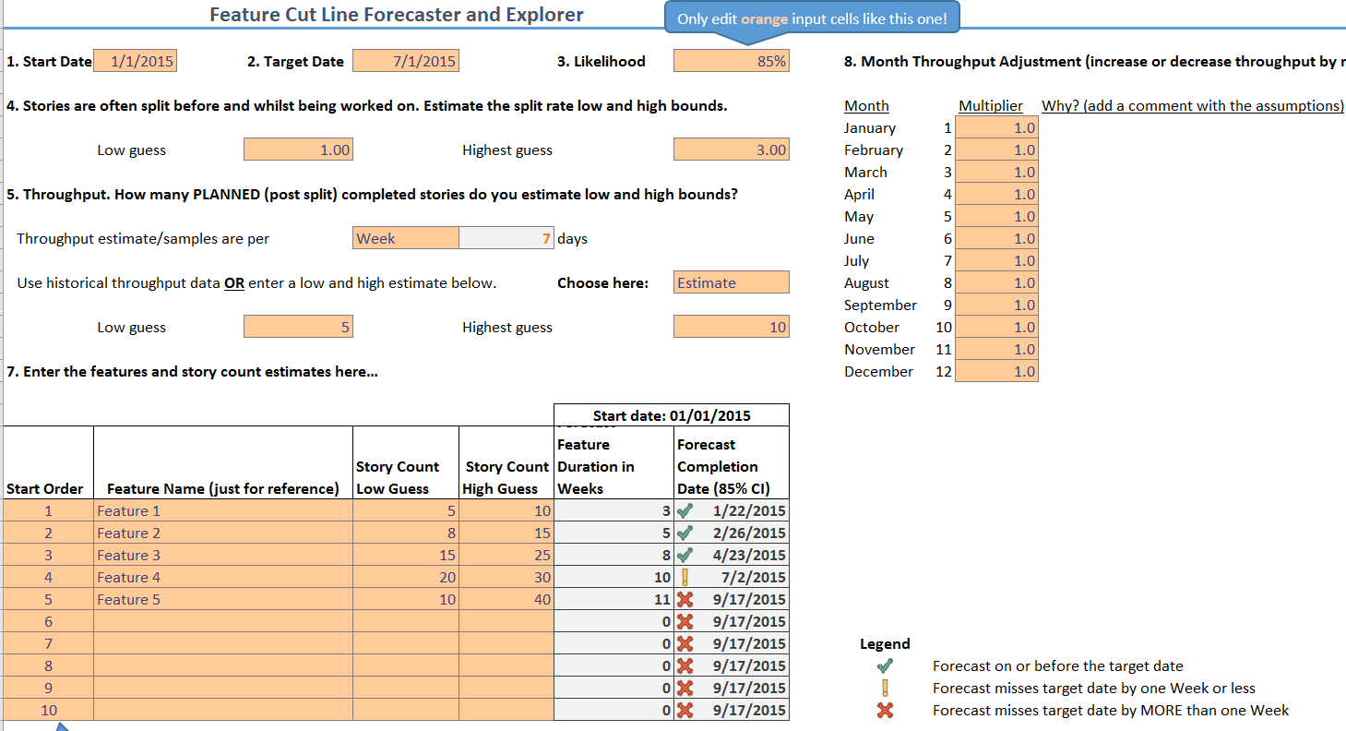
Forecasting
How Big
How Long
How Much
Fails
Q and A

Slide 25
Give multiple options – discuss cuts early
Forecasting
How Big
How Long
How Much
Fails
Q and A

Slide 26
Top Three Forecasting Fail Reasons
Forecasting
How Big
How Long
How Much
Fails
Q and A
Reasons you shouldn’t have hired me five years ago

Slide 27
Fail 1: Start Date On-Paper != Reality
Forecasting
How Big
How Long
How Much
Fails
Q and A
Start Date of Feature B is the finish date of Feature A
What is the team doing now?
The assumed Start Date is often ONLY on paper
Define what start means
Team is dedicated and in-place
They are trained and know how to do their work
They know and understand what work they need to deliver
Nothing inhibits them doing or delivering that work
Team is never fully available on day one!

Slide 28
Fail 2: Backlog Rate versus Delivery Rate
Forecasting
How Big
How Long
How Much
Fails
Q and A
Features
Estimated Stories
Implemented Stories and Defects
Feature
1
2
1a
1b
2
3
3a
3b
3c
Feature
1
1a
1b
1
2a
2b
1
2
Feature
2c
Actual Backlog Rate Delivered = 6
Measured Throughput = 12

Slide 29
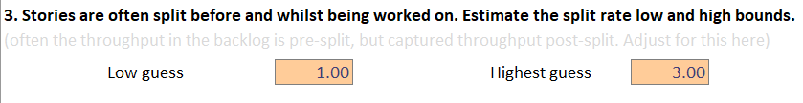
Fail 2: Backlog Rate versus Delivery Rate
Forecasting
How Big
How Long
How Much
Fails
Q and A
Forecast using the “Completion rate” we may under-forecast
Backlog is Miles per Hour, Completion rate is Kilometers per Hour
Normal split rates are between 1 to 3 times (most common seen)
This means
If you don’t account for it, you will UNDER-FORECAST by 1 to 3 times!

Slide 30
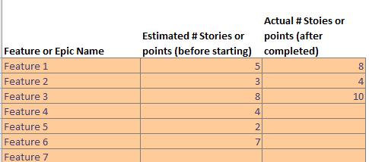
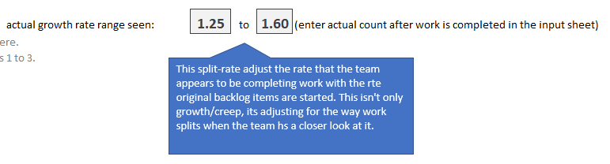
Forecasting
How Big
How Long
How Much
Fails
Q and A
5 X 1.6 = 8
3 X 1.3 = 4
8 X 1.25 = 10

Slide 31
Fail 3: Ignoring Risks
Forecasting
How Big
How Long
How Much
Fails
Q and A
Risk = Work that “might” need to be done but we don’t know yet
Some samples
Fails on Internet Explorer 6, or now Safari on phones
Fails performance testing under load, or uses too much memory
CSS alignment issues with German text translations, things wrap
Production network security blocks traffic, awaiting vendor to fix
Fails on real customer data (we designed for 50 items, they have 500)

Slide 32
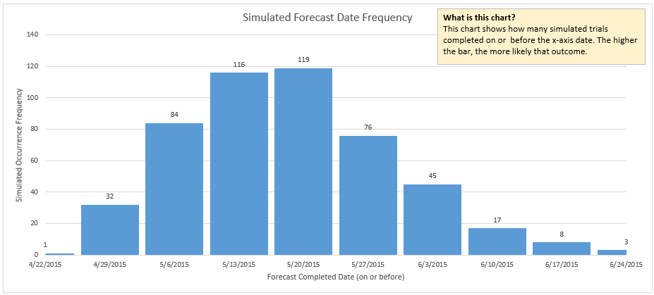
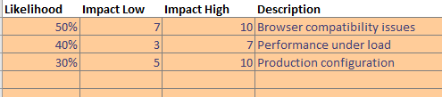
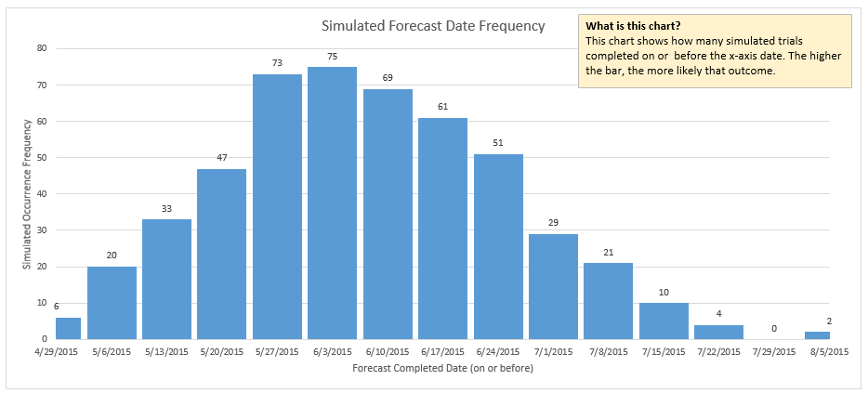
Forecasting
How Big
How Long
How Much
Fails
Q and A
WITHOUT RISKS INCLUDED
27th May (highest late June)
24th June (highest early August)
WITH RISKS INCLUDED
Forecasts shown at 85th Percentile

Slide 33
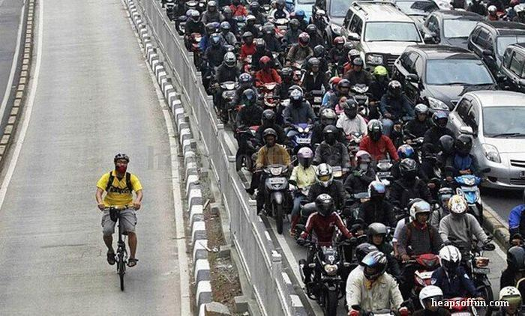
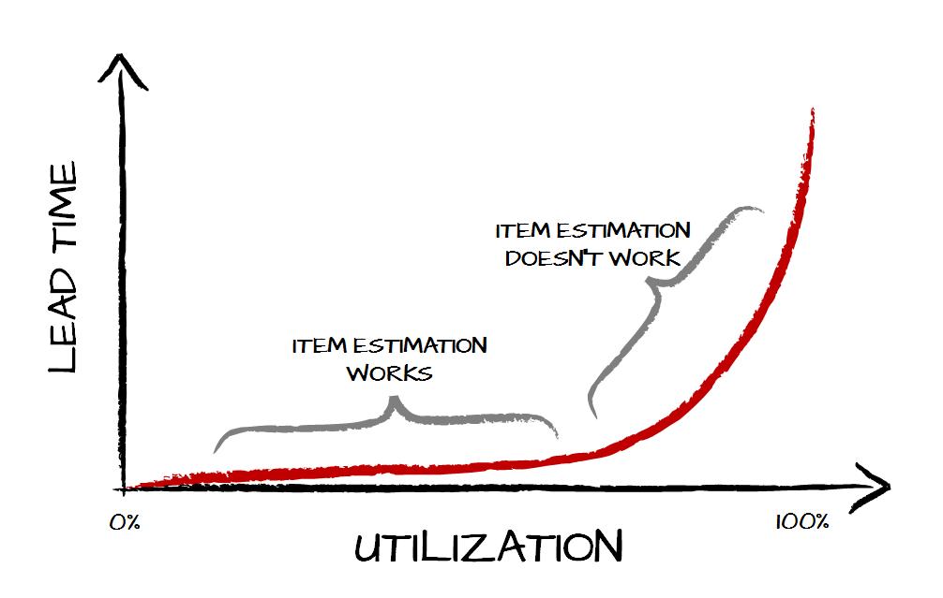
Root of All Fails: High System Utilization
Forecasting
How Big
How Long
How Much
Fails
Q and A
Can’t forecast high utilization systems using item size…

Slide 34
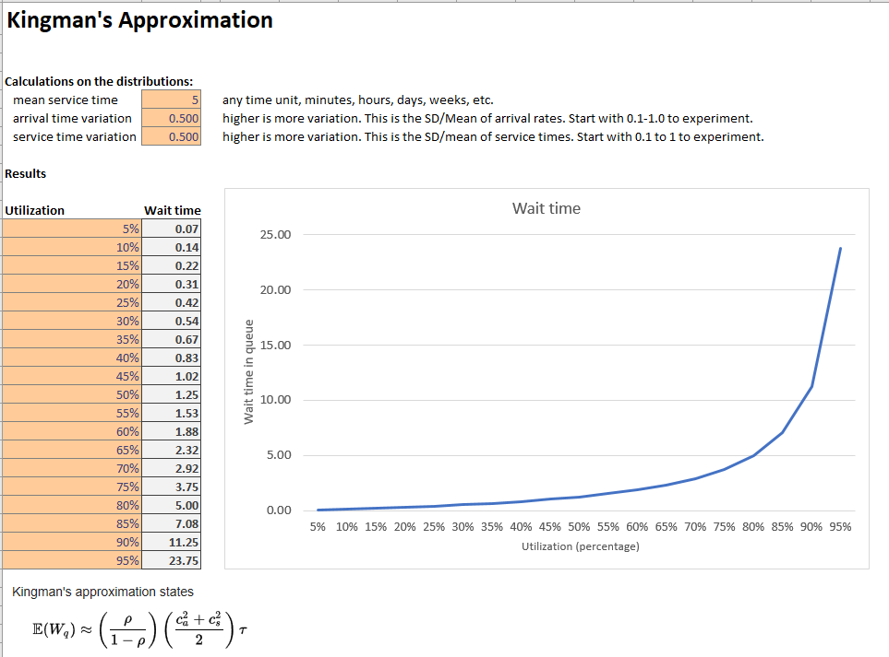
Forecasting
How Big
How Long
How Much
Fails
Q and A
Estimated Wait Time (y)
At Utilization % (x)
Action: Experiment with “Kingmans Formula.xlsx”
Arrival Time Variation AND Service Time Variation Equally Impactful

Slide 35
Forecasting
How Big
How Long
How Much
Fails
Q and A
Throughput per week for 100 teams
NOTHING you can estimate poorly will be as DAMAGING as a bad process or poor management policy

Slide 36
Forecasting
How Big
How Long
How Much
Fails
Q and A
Cumulative Throughput per week for 100 teams
WTF 2?
Avoid cumulative charts for *SHORT* term forecasting, they over-smooth short term trends
WTF 1?

Slide 37
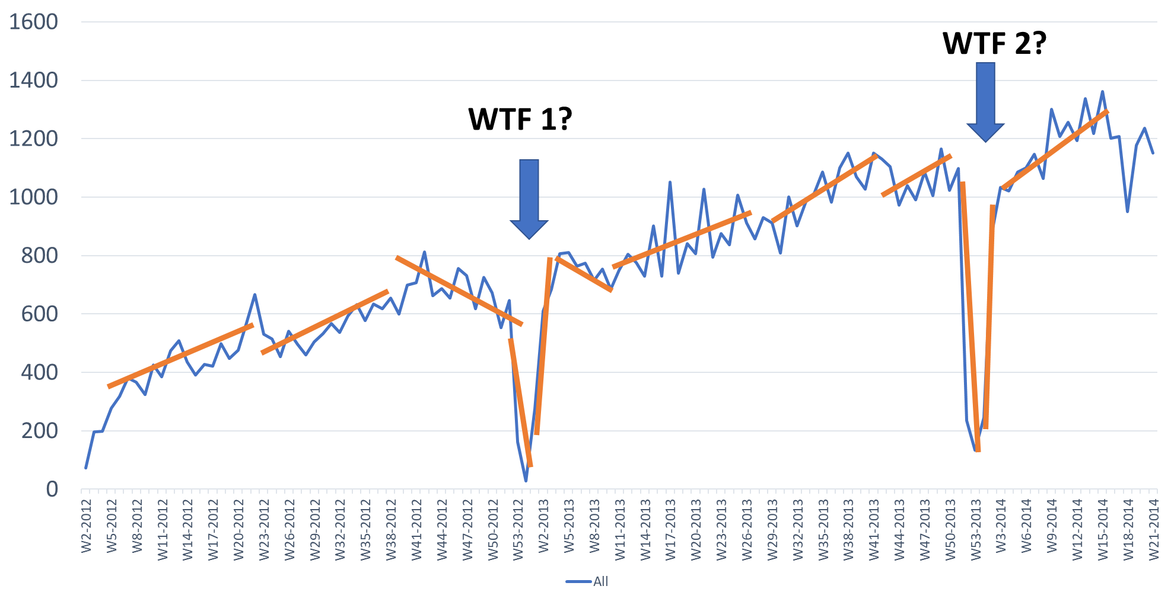
Forecasting
How Big
How Long
How Much
Fails
Q and A
Use RECENT trends for shorter term contextual forecasts
Use cumulative trends for longer term forecasts
Eg. Individual stock this year
Eg. S&P500 over 10 years

Slide 38
Key Take-aways and Resources
Forecasting
How Big
How Long
How Much
Fails
Q and A
Forecasting requires a system view,
Three samples will outperform intuition (use most recent 7 samples)
Give multiple options, not just one
Forecast duration NOT date until “Start Conditions” are defined
Track actual progress versus planned, and update the model continuously
Get everything here: Slides and tools:
Bit.ly/SimResources

Slide 39

Forecasting
How Big
How Long
How Much
Fails
Q and A
Get everything here: Slides and tools: Bit.ly/SimResources
Me on Twitter
@t_magennis

Slide 40
About me…
What I do
Teach how to use data for forecasting
Teach simple math to executives, especially “demand > supply”
Teach how to know (earlier) that you are on the wrong side of an expectation
What I did
Started in software 1986. I actually liked Assembler & Cobol
Have worked at senior exec level, and now beside them for major corporations so I have some insight into what passes their decision filters
How to reach me
Twitter: @t_magennis or email: troy.magennis@focusedobjective.com
Lots of free spreadsheets and stuff at FocusedObjective.com

Slide 41
Forecasting
How Big
How Long
How Much
Fails
Q and A
Forecasting is… answering the right question, to a transparent degree of certainty, with as little effort as possible.
Notes:
Forecasting revolves around answering questions.
Mostly those questions are about an uncertain future, so we can’t be certain.
Its up to use to be very clear about how certain we are. The answer is going to be used for decision, and uncertainty is an important part of that equation.
And, we need to know how to do it fast. We can improve all forecast by spending more time analyzing, but that’s not the goal.
The goal is to be better than what is currently done. That’s pretty low bar!
I want to emphasize, the right question part of this definition.
When will I be done is a terrible question. When do we need it is a better question, then how can we achieve that. Avoid the when will it be done at all costs.

Slide 42
Good versus Poor Forecasting
Forecasting
How Big
How Long
How Much
Fails
Q and A
I think the Google comparison slide is more compelling
Poor Forecasting
Good Forecasting
Based on “intuition” alone
One option without details
Shows a calendar date (with assumed fixed start date)
Re-planning seen as failure; New information slowly (if at all) incorporated
Based on “intuition” and “data”
Many options with details
Shows duration until commitment
Continuously updated and “rerouted” based on new information

Slide 43
Top Three Forecasting Opportunities
Forecasting
How Big
How Long
How Much
Fails
Q and A
I think I can cover these as we go. Better explanation with examples of the problems.
Understanding options
knowing that more than one way works
Under-invest versus over-invest
Sampling
getting the same result for less effort
Defining a better start order (prioritization)
We often optimize for value alone…

Slide 44
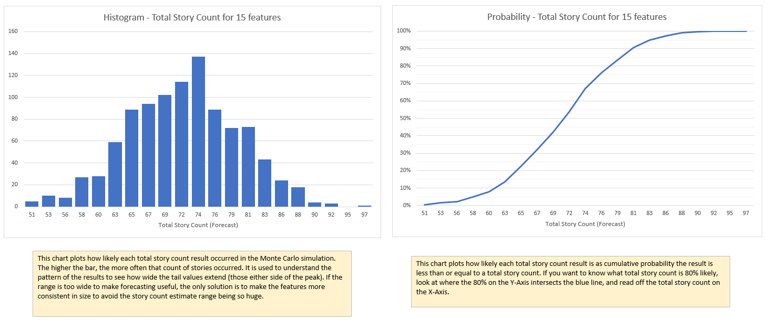
Forecasting
How Big
How Long
How Much
Fails
Q and A
50% = 72
90% = 81
90% = 81
50% = 72

Slide 45
How Big – Forecasting feature/project size
Forecasting
How Big
How Long
How Much
Fails
Q and A
First, can we avoid the question (quantitatively)
“When is it needed?” – perhaps it’s an easy binary answer of yes or no
“Compared to what?” – perhaps it’s an easy binary answer of bigger or smaller
Then,
Do we know enough to perform a forecast?
Are the Knowns > Un-knowns
If we do need a size forecast,
How can we forecast with the minimal effort possible:
Reference class forecasting
Sampling
Notes:
Estimating size seems to be an emotional trigger for many people. I’m going to show you a couple of ways to answer the size question rapidly.
Neither of these techniques use story point estimation or planning poker. Not that there is anything wrong with those techniques, just they are relatively slow and stressful to produce for the detail we need.
The first call to action is to avoid quantitatively answering this question prematurely. Determine what your answer will cause. Often, the stakeholder is asking to feel out viability.
Asking “When is it needed?” achieves an almost instant answer, and everyone can move on.

Slide 46
How Long – Forecasting duration (and date)
Forecasting
How Big
How Long
How Much
Fails
Q and A
First, can we avoid the question
“When is it needed?” – perhaps it’s an easy binary answer of yes or no
“Compared to what?” – perhaps it’s an easy binary answer of longer or shorter
Then,
Do we know enough to perform a forecast?
Are the risks and unknowns larger than the knowns – perhaps it’s a pointless question now
If we do need a duration forecast,
How can we forecast with the minimal effort possible:
Use range estimates
Use Monte Carlo forecasting

Slide 47
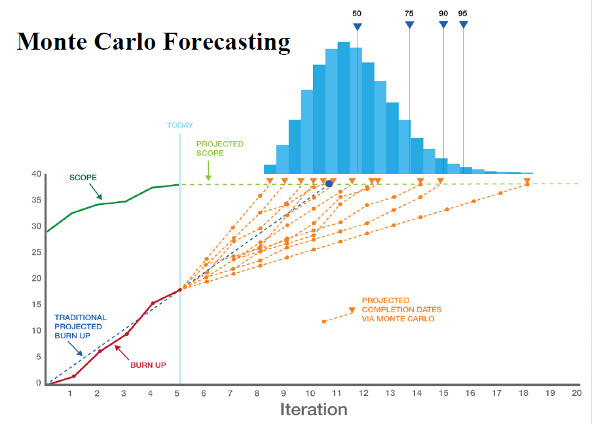

Image thanks to Larry Maccherone

Slide 48
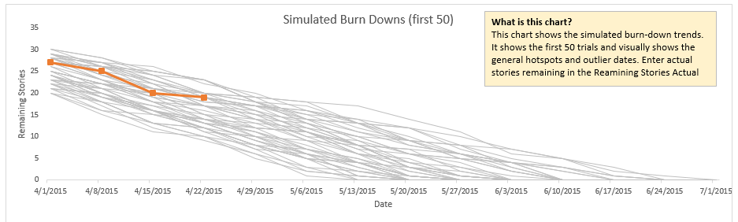
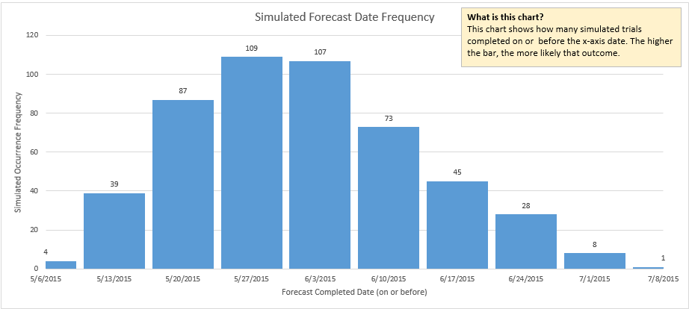
Forecasting
How Big
How Long
How Much
Fails
Q and A
Process –
1. Simulated project burn-downs are created, say 1000 of them.
2. The number of trials for each duration allows probability to be calculated.
3. If we have throughput or velocity data, it is used rather than the range estimate.

Slide 49
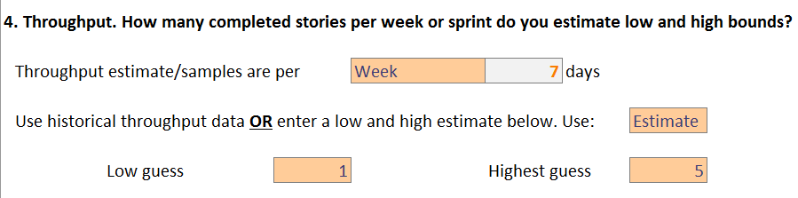
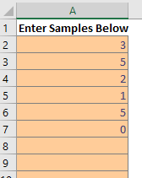
Using range estimates or data?
Forecasting
How Big
How Long
How Much
Fails
Q and A
< 11 samples (in context)
11+ samples
(in context)
None
Use a uniform range estimate
Use data to adjust uniform range estimate boundaries
Use data.
Monitor distribution weekly for changes
Select “Data” rather than “Estimate” to use samples

Slide 50
Slides, spreadsheets, and other stuff Bit.ly/SimResources
Everything you see is freely available

